Slide 1

Machine Vision
Wu Wei

Slide 2
Images Enhancement
01
02
03
04
05
Gray Level Transformations
Histogram Processing
Arithmetic/Logical Operation
Spatial Filtering
Frequency Filtering

Slide 3
Image Enhancement
principle objective of Image enhancement
To process an image so that the result is more suitable than the original image for a specific application.
specific: Problem Oriented
Highlighting interesting detail in images
Removing noise from images
Making images more visually appealing
De-emphasizing things in an image
Finding things in an image
……

Slide 4
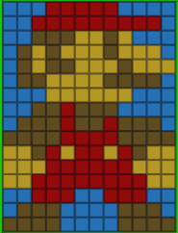
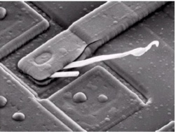
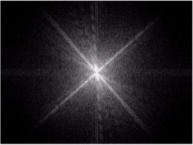
Image Enhancement
Categories of image enhancement approaches
Spatial Domain Methods
The image plane itself
Direct manipulation of pixels in an image
Frequency Domain Methods
Consider the image as a 2D signal and apply Fourier transform
Process the image in the transformed domain
Apply the inverse transform to return into the spatial domain.
No general theory of image enhancement
“good image” is an elusive standard for visual evaluation

Slide 5
PART 1
Gray Level Transformations

Slide 6
Image Enhancement
Basics
Intensity transformation and spatial filtering
g (x, y) = T[ f (x, y)]
f (x, y) : input image g (x, y) : output image T : an operator applied to the image f (x, y)
In the discrete case
• f and g are 2D matrices of size W × H
T is a matrix of size w × h which is much smaller than W × H
The value of each pixel of g is the result of applying the operator T at the corresponding location in f.
If w × h= 1×1 →intensity transform
Otherwise, it’s spatial filtering.
Origin
x
(x, y)
y
Image f (x, y)

Slide 7
Image Enhancement
Basic Gray Level Transformations
The simplest spatial domain operations occur when the neighbourhood is simply the pixel itself
In this case Point processing operations take the form
s = T ( r )
T : a grey level transformation function or a point processing operation
s : processed image pixel value r : original image pixel value

Slide 8
Image Enhancement
Basic Gray Level Transformations
Examples
Image negatives
Log transformations
Power-law (Gamma) transformations
In the following
Each image is represented with a 2D matrix of L intensity levels. That is each pixel takes a value between 0 and L-1

Slide 9
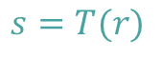
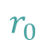


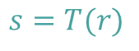





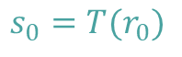
Image Enhancement
Basic Gray Level Transformations
$$s=T(r)$$
$$s=T(r)$$
$$s_{0}=T(r_{0})$$
$$Dark↔Light$$
$$Dark↔Light$$
$$r_{0}$$
$$r$$
$$r$$
$$k$$
$$Dark↔Light$$
$$Dark↔Light$$
Contrast stretching
Threshold function
Produce an image of higher contrast by darkening the levels below k and brightening the levels above k in the original image, known as contrast stretching.
In the limiting case, T(r) produces a two-level (binary) image, known as thresholding.

Slide 10
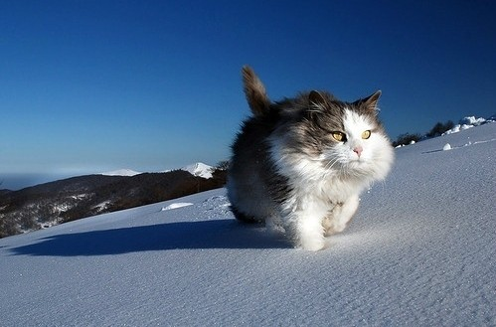
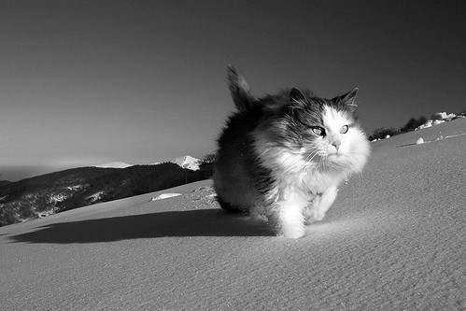
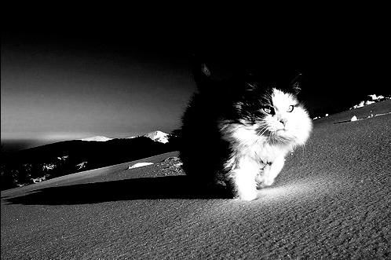
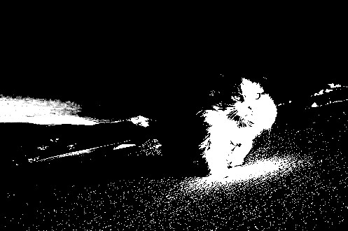
Image Enhancement
Basic Gray Level Transformations

Slide 11
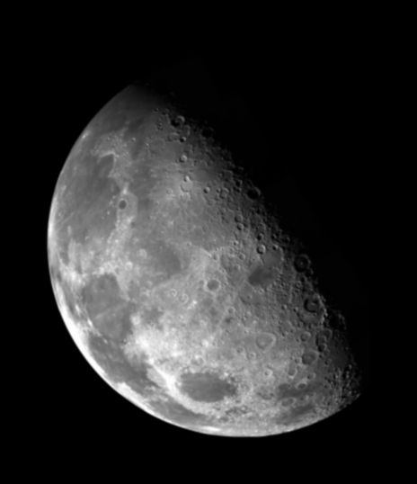

Image Enhancement
Basic Gray Level Transformations
Thresholding transformations are useful for segmentation in which we want to isolate/emphasize an object of interest from a background
Result called “BINARY” image.
255, r≥ threshold
s =
0, r ＜ threshold
Original image
Thresholding transformation

Slide 12
Basic Gray Level Transformations
Image negatives
Log transformations
Power-law (Gamma) transformations
Piecewise Linear Transformation

Slide 13
Basic Gray Level Transformations
Negative transformation
L-1
s = L – 1 - r
negative
It is particularly suited for enhancing white or gray detail embedded in dark regions of an image, especially when the black areas are dominant in size
Output gray level s
original
L/2
0
L/2
L-1
Input gray level r
Original image
Negative transformation

Slide 14
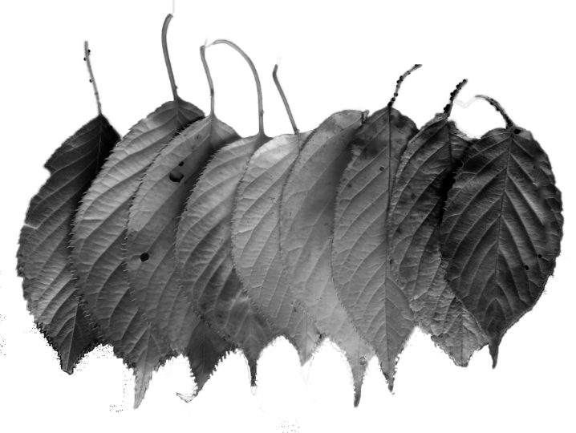
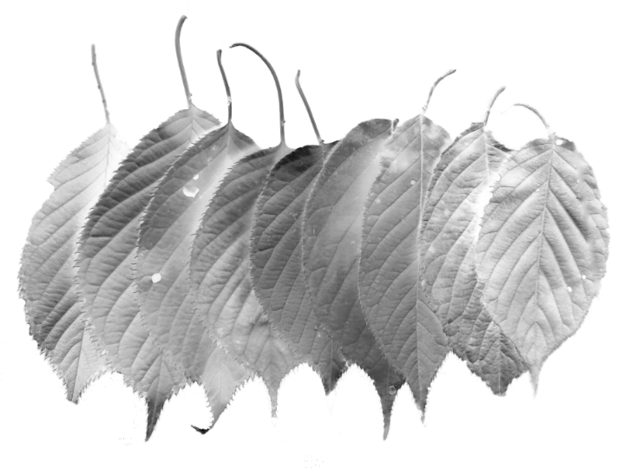



Basic Gray Level Transformations
Negative transformation

Slide 15
Basic Gray Level Transformations
Image negatives
Log transformations
Power-law (Gamma) transformations
Piecewise Linear Transformation

Slide 16
Basic Gray Level Transformations
Log transformation
L-1
s = c · log(1 + r)
Log
nth root
Output gray level s
The log transformation maps a narrow range of low input grey level values into a wider range of output values
The inverse log transformation performs the opposite transformation
L/2
nth power
Inverse log
0
L/2
L-1
Input gray level r

Slide 17

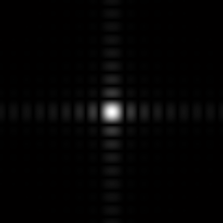
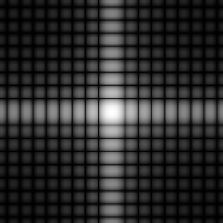
Basic Gray Level Transformations
Log transformation
In Fourier transform, we usually encounter spectrum values that ranges from 0 to 10⁶ or higher. But image display system cannot reproduce such a wide range of intensity values.
We usually set c to 1.
s = log(1 + r)
Original image
Fourier transform
Log transform of FT

Slide 18
Basic Gray Level Transformations
Image negatives
Log transformations
Power-law (Gamma) transformations
Piecewise Linear Transformation

Slide 19
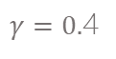
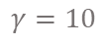
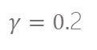
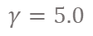
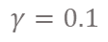
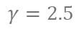
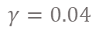
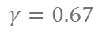
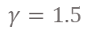
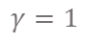
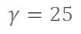
Basic Gray Level Transformations
Power-law (Gamma) transformations
L-1
s = c · r ^{γ}
$$γ=0.04$$
$$γ=0.1$$
$γ=0.$2
Map a narrow range of dark input values into a wider range of output values or vice versa
Varying γ gives a whole family of curves
$γ=0.$4
Output gray level s
$$γ=0.67$$
L/2
$$γ=1$$
$$γ=1.5$$
$$γ=2.5$$
$$γ=5.0$$
$$γ=10$$
$$γ=25$$
0
L/2
L-1
Input gray level r

Slide 20
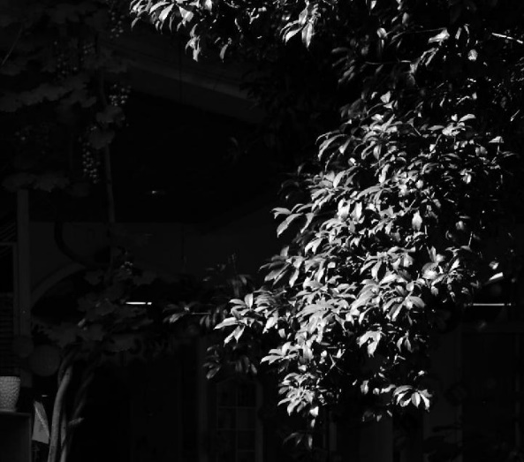
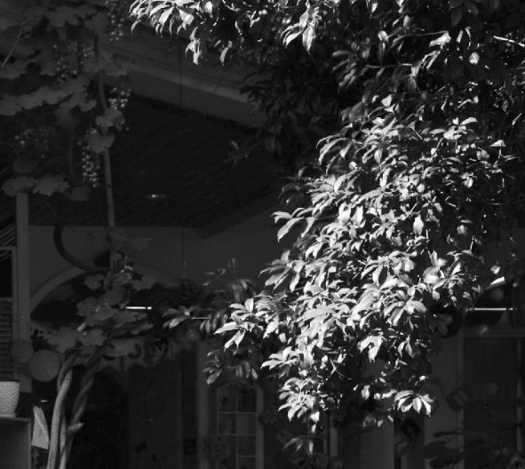
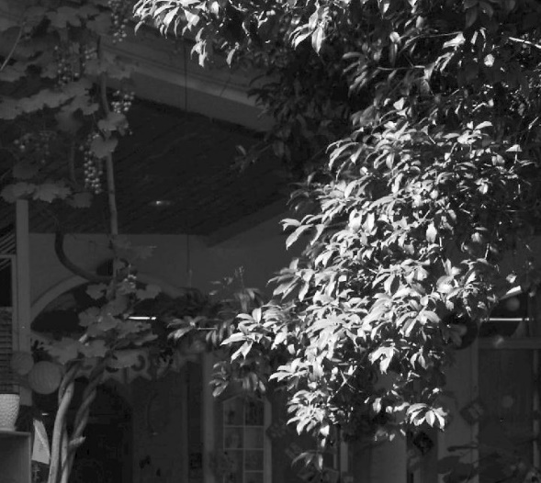
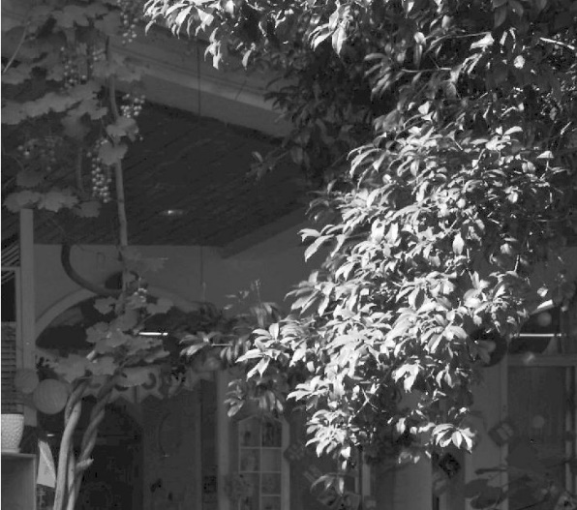
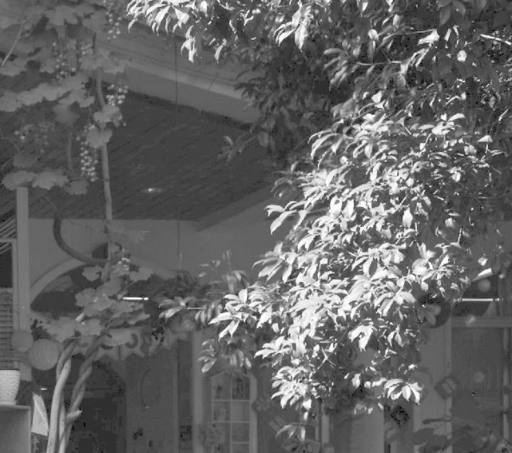
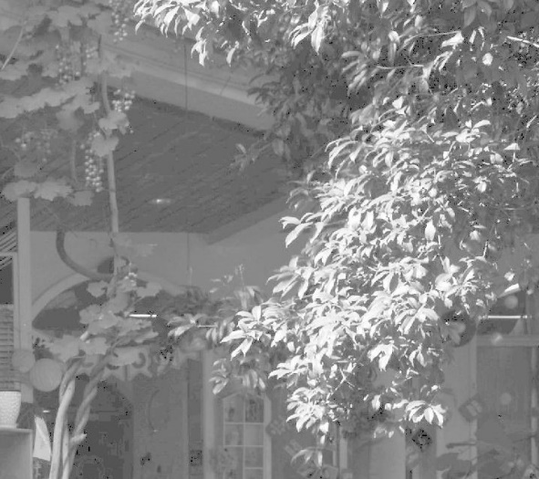
Basic Gray Level Transformations
Power-law (Gamma) transformations
原始图像
r = 0.6
r = 0.4
r = 0.3
r = 0.5
r = 0.2

Slide 21
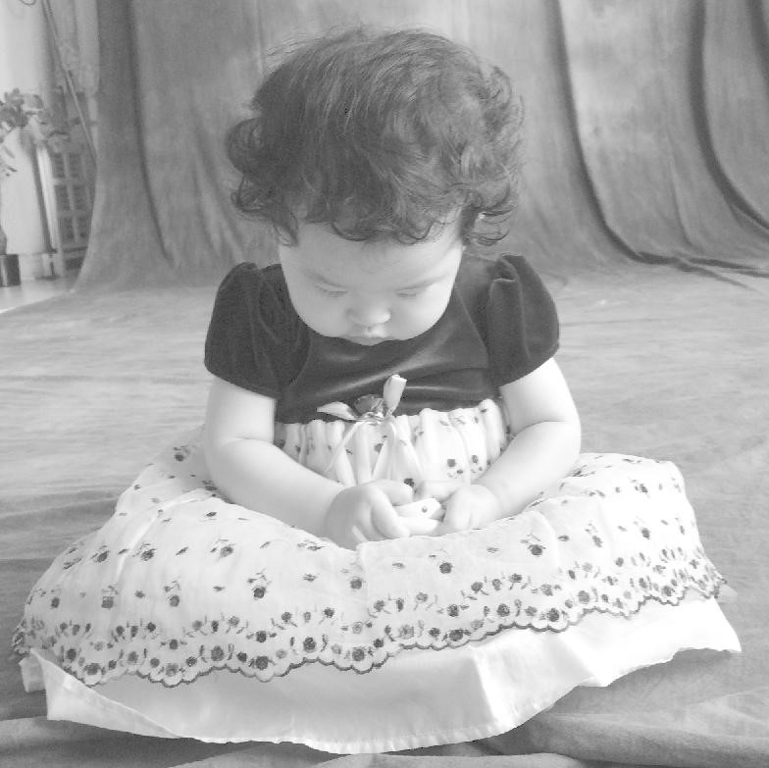
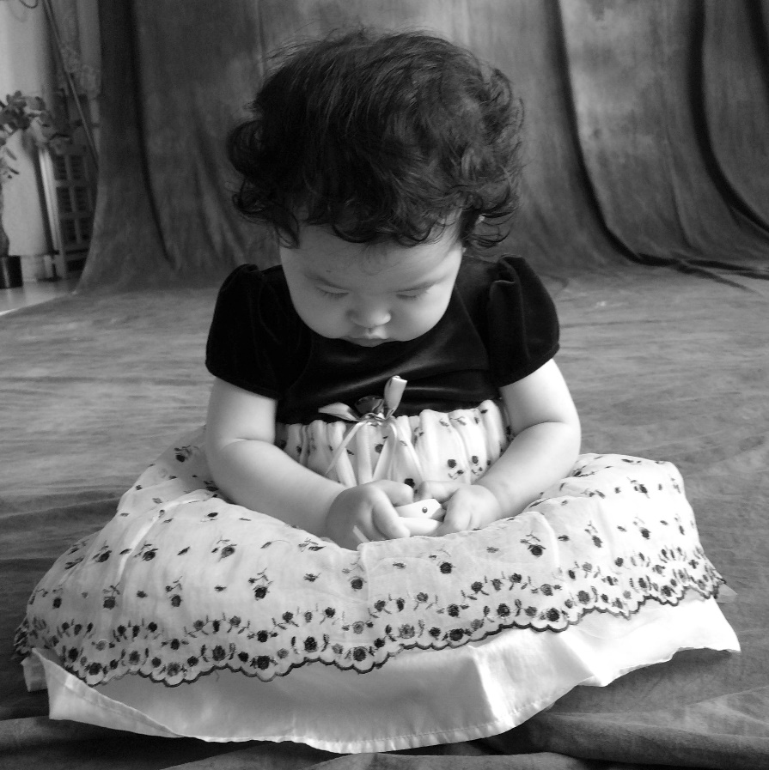
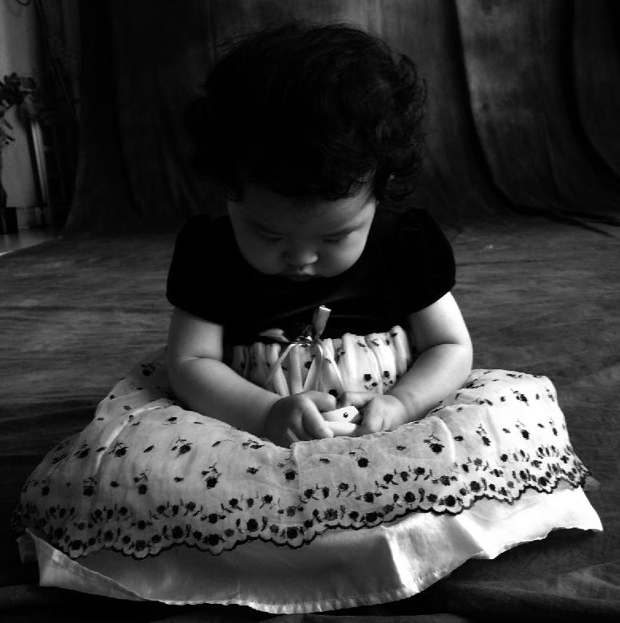
Basic Gray Level Transformations
Power-law (Gamma) transformations
r = 0.3
Original Image
r = 1.6

Slide 22

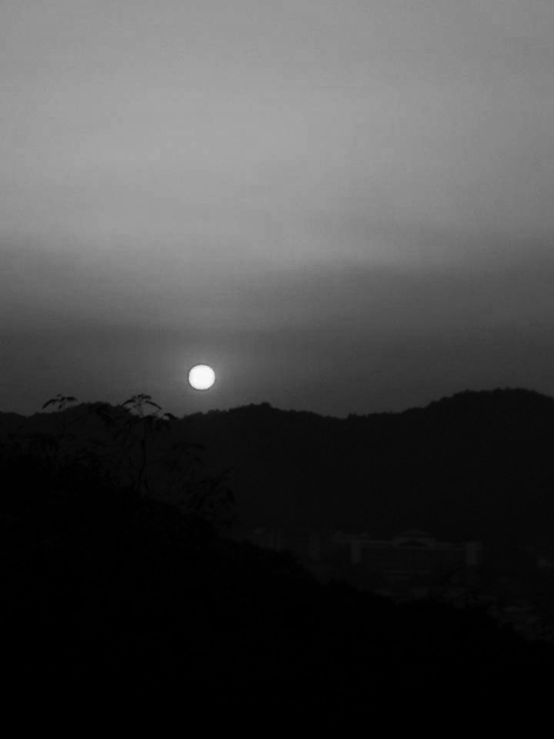
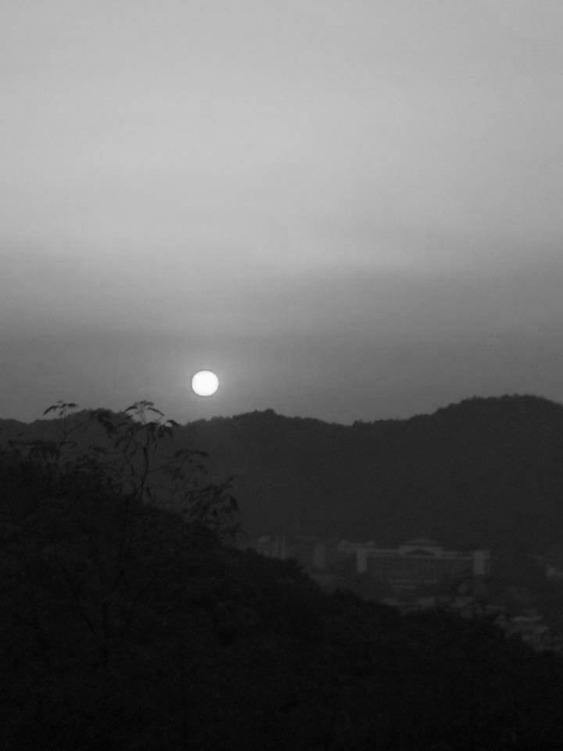
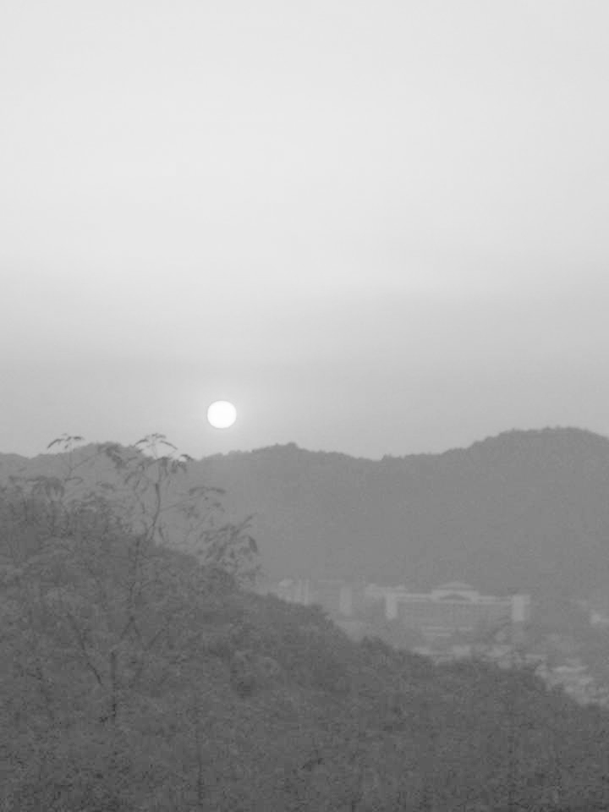
Basic Gray Level Transformations
Power-law (Gamma) transformations
Original Image
r = 3
r = 1
r = 0.6

Slide 23
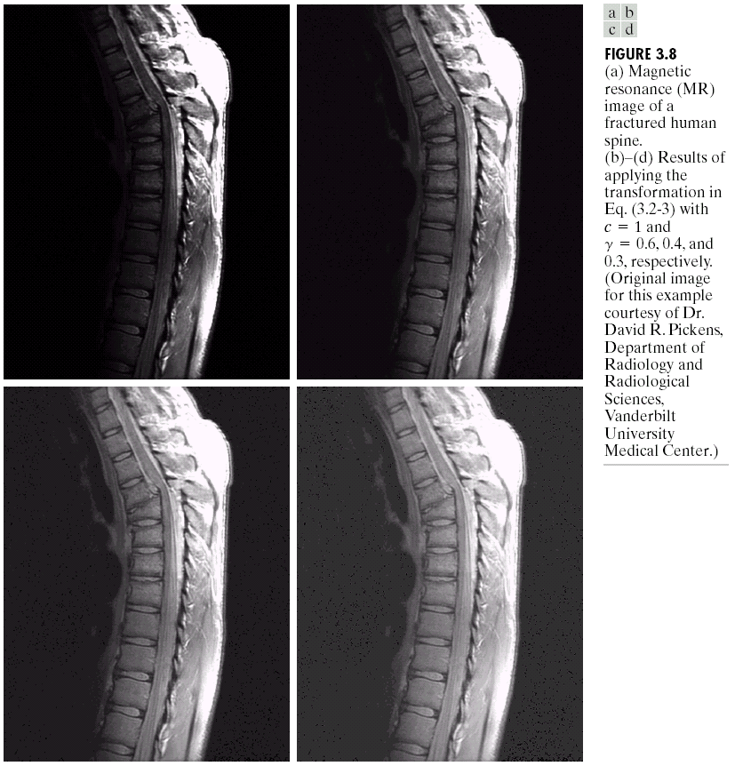
Basic Gray Level Transformations
Power-law (Gamma) transformations
The images to the right show a magnetic resonance (MR) image of a fractured human spine
The given image is pre-dominantly dark, so an expansion of gray levels are desirable. This can be accomplished with a power-law transformation with a fractional exponent.
Original image

Slide 24
Basic Gray Level Transformations
Power-law (Gamma) transformations
s = r ^{0.6}
s = r ^{0.4}
s = r ^{0.3}

Slide 25
Basic Gray Level Transformations
Power-law (Gamma) transformations
Gamma Correction
Many of you might be familiar with gamma correction of computer monitors.
Problem is that display devices, print devices do not respond linearly to different intensities, and they respond according to a power law:
For CRT display, γ=1.8~2.5
Can be corrected using a power law transformation:

Slide 26
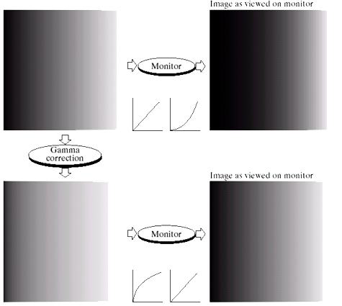
Basic Gray Level Transformations
Power-law (Gamma) transformations
Gamma Correction
γ=2.5
γ=1/2.5=0.4

Slide 27
Basic Gray Level Transformations
Power-law (Gamma) transformations
Gamma Correction
Prior Knowledge about gamma correction
Varying the value of gamma correction changes not only the brightness, but also the ratio of red to green to blue.
Applications
Internet
Millions of people and millions of monitors
Gamma represents an “average ”of the types of monitors and computer systems
Scanners, Printers have different values of gamma

Slide 28
Basic Gray Level Transformations
Image negatives
Log transformations
Power-law (Gamma) transformations
Piecewise Linear Transformation

Slide 29
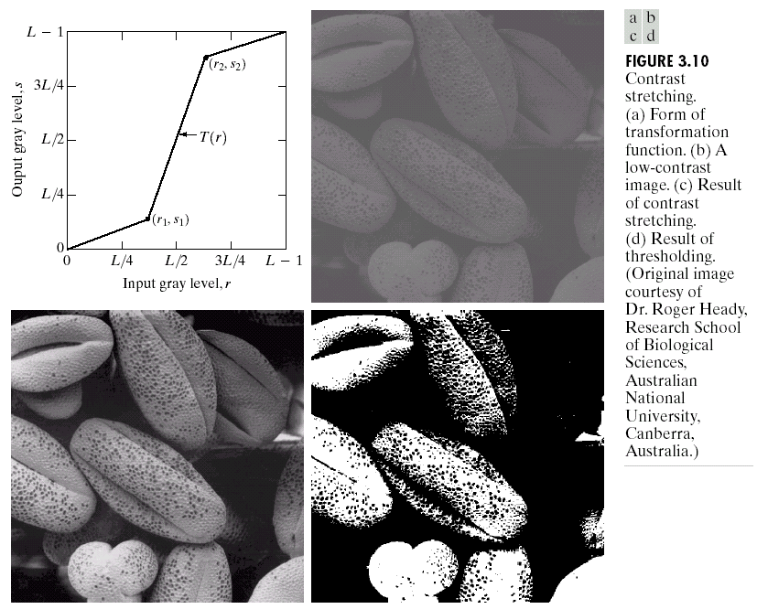
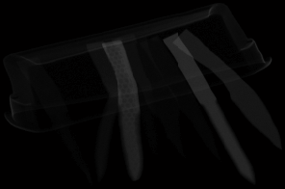

Basic Gray Level Transformations
Piecewise Linear Transformation
Rather than using a well defined mathematical function we can use arbitrary user-defined transforms
The images below show a contrast stretching linear transform to add contrast to a poor quality image
？

Slide 30
Basic Gray Level Transformations
Piecewise Linear Transformation
r₁=r₂=m
(r₁,s₁)=(r_{min},0)
(r₂,s₂)=(r_{max},L-1)

Slide 31

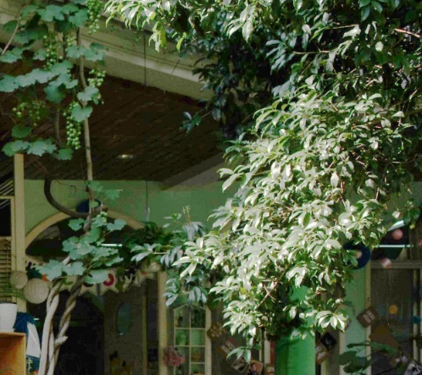

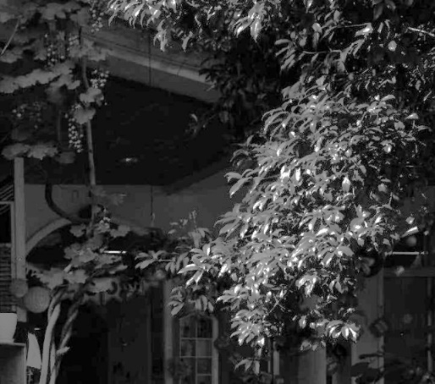
Basic Gray Level Transformations
Piecewise Linear Transformation
L-1
Output gray level s
$$γ=1$$
L/2
Original image
PLT
0
L/2
L-1
Input gray level r
Gray image
PLT

Slide 32
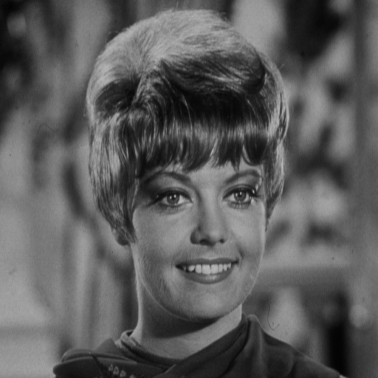
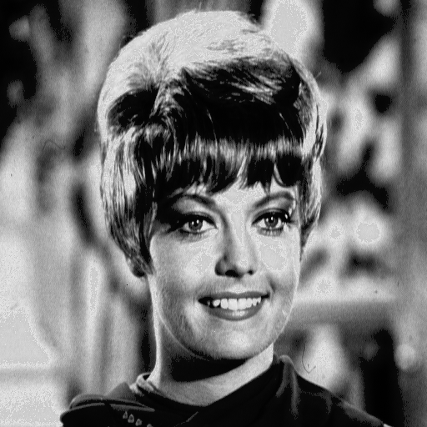
Basic Gray Level Transformations
Piecewise Linear Transformation
y_{b}
y_{a}
x
0
a
b
L

Slide 33
PART 2
Histogram Processing

Slide 34
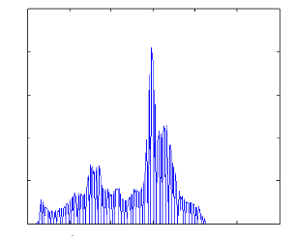
Histogram Processing
Definition
– The histogram function is defined over all possible intensity levels.
– For each intensity level, its value is equal to the number of the pixels with that intensity.
Applications
– Image enhancement, compression, segmentation
– Very popular tool for real time image processing
Image
2500
2000
1500
1000
500
0
0 50 100 150 200 250 300
Histogram

Slide 35
Histogram Processing
Image 5x5
0 1 2 3 4 5 6 7

Slide 36
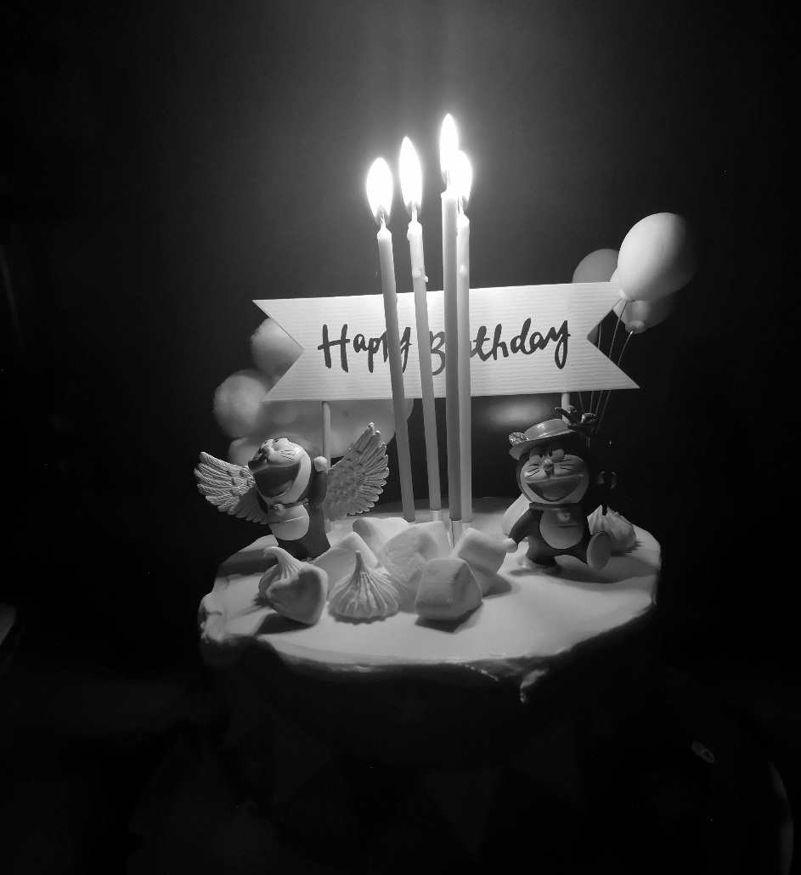
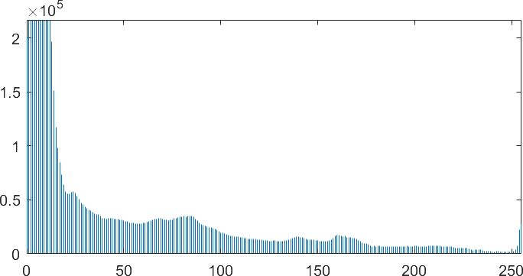
Histogram Processing
Image
Histogram

Slide 37


Histogram Processing
Image
Histogram

Slide 38


Histogram Processing
Image
Histogram

Slide 39








Histogram Processing
Dark Image
Low Contrast
Bright Image
High Contrast
It is reasonable to conclude that an image whose pixels tend to occupy the entire range of possible gray levels and, in addition, tend to be distributed uniformly, will have an appearance of high contrast and will exhibit a large variety of gray tones, thus will be an image that shows a great deal of gray-level detail and has high dynamic range.

Slide 40

Histogram Processing
Histogram equalization
s=T(r) 0≤r≤L-1
T is single-valued and monotonically increasing
s is value-limited in [0,L-1]

Slide 41
Histogram Processing
Histogram equalization
PDF relation between p_{s} and p_{r}
If the cumulative distribution function is used as the transform
then the PDF of the transformed image is

Slide 42
Histogram Processing
Histogram equalization
Transform function
is the probability density function (pdf)
The transform function is the cumulative distribution function (CDF)
Why ? To make the pdf of the transformed image uniform, i.e., to make the histogram of the transformed image uniform.

Slide 43
Histogram Processing
Histogram equalization
HE - discrete form
HE steps
G – Number of gray levels, N – Number of pixels
Calculate the histogram H[r], r=0,2,…G-1
Normalize the histogram H[r] = H[r]/N;
Form the CDF: Hc[0] = H[0], Hc[r] = Hc[r-1] + H[r]
Set s = T[p] = round (Hc[p] (G-1))

Slide 44
Histogram Processing
Histogram equalization
Example
Do histogram equalization on the 5x5 image with integer intensities in the range between one and eight
Intensity
transformation function
T(r₀) = 0.32*7
T(r₁) = (0.32+0.16)*7=0.48*7
T(r₂) = (0.32+0.16+0.12)*7=0.60*7
T(r₃) = (0.32+0.16+0.12+0.08)*7=0.68*7
T(r₄) = … = 0.76*7
T(r₅) = … = 0.76*7
T(r₆) = … = 0.80*7
T(r₇) = … = 1.00*7
Histogram value
after HE
s₀ = 2.24 → 2
s₁ = 3.36 → 3
s₂ = 4.42 → 4
s₃ = 4.76 → 5
s₄ = 5.32 → 5
s₅ = 5.32 → 5
s₆ = 5.60 → 6
s₇ = 7.00 → 7
PDF r
p(r₀) = 8/25 = 0.32
p(r₁) = 4/25 = 0.16
p(r₂) = 3/25 = 0.12
p(r₃) = 2/25 = 0.08
p(r₄) = 2/25 = 0.08
p(r₅) = 0/25 = 0.00
p(r₆) = 1/25 = 0.04
p(r₇) = 5/25 = 0.20

Slide 45


Histogram Processing
Histogram equalization

Slide 46

Histogram Processing
Histogram equalization

Slide 47

Histogram Processing
Histogram equalization

Slide 48
Histogram Processing
Histogram equalization
Adaptive histogram equalization:
Properties
The size of the neighborhood region is a parameter of the method. It constitutes a characteristic length scale: contrast at smaller scales is enhanced, while contrast at larger scales is reduced.
When the image region containing a pixel's neighborhood is fairly homogeneous, its histogram will be strongly peaked, and the transformation function will map a narrow range of pixel values to the whole range of the result image. This causes AHE to over amplify small amounts of noise in largely homogeneous regions of the image.
Must limit contrast expansion in flat regions of the image, e.g. by clipping individual histogram values to a maximum (CLAHE - “Contrast-limited adaptive histogram equalization”) [Pizer, Amburn et al. 1987]

Slide 49
Histogram Processing
Histogram equalization
Adaptive histogram equalization:
Original image
Global histogram equalization
Adaptive histogram equalization
3×3

Slide 50
Histogram Processing
Histogram equalization
Adaptive histogram equalization:
Original image
Global histogram equalization
Adaptive histogram equalization
8×8
Adaptive histogram equalization
32×32

Slide 51

Histogram Processing
Histogram equalization
Adaptive histogram equalization:
Dental Xray
Original image
Global histogram equalization
Adaptive histogram equalization
16×16

Slide 52

Histogram Processing
Histogram equalization
Adaptive histogram equalization:
Original image
Global histogram equalization
Adaptive histogram equalization
8×8

Slide 53
PART 3
Arithmetic/Logical Operation

Slide 54
Arithmetic/Logical Operation
Logic Operations
Logic Operations
Image Subtraction
Image Averaging

Slide 55
Arithmetic/Logical Operation
Logic Operations
AND
OR

Slide 56
Arithmetic/Logical Operation
Logic Operations
Logic Operations
Image Subtraction
Image Averaging

Slide 57
Arithmetic/Logical Operation
Image Subtraction
f and h are two images.
Note: most images are displayed using 8 bits (even 24-bit color images consists of three 8 bit channels). Thus we expect image values not to be outside the range from 0 to 255.
In subtraction, the results should be in the range -255 to 255. so some sort of scaling is required to display the results.
Add 255 and then divide by 2
y=x-min(x); z=y*255/max(y).

Slide 58

Arithmetic/Logical Operation
Image Subtraction
（Digital Subtraction Angiography，DSA）

Slide 59

Arithmetic/Logical Operation
Image Subtraction
（a）
（b）
Enhancement by image subtraction.
(a) Mask image. (b) An image (taken after injection of a contrast medium into the bloodstream) with mask subtracted out.

Slide 60
Arithmetic/Logical Operation
Image Subtraction
Change detection is another major application by using image subtraction. Such as:
Tracking moving vehicles
Tracking walking persons
Change detections

Slide 61

Arithmetic/Logical Operation
Image Subtraction

Slide 62
Arithmetic/Logical Operation
Image Subtraction
Two consecutive frames

Slide 63
Arithmetic/Logical Operation
Image Subtraction
Simple difference image
Simple difference image thresholded
Image after thresholded

Slide 64

Arithmetic/Logical Operation
Image Subtraction
Image A (no defect)
Image B (with defect)
A – B (alignment)
A – B (alignment and thresholding)

Slide 65
Arithmetic/Logical Operation
Logic Operations
Logic Operations
Image Subtraction
Image Averaging

Slide 66

Arithmetic/Logical Operation
Image Averaging
A noisy image:
Where n(x) is the noise, and it has zero average value
Then Averaging M different noisy images can reduce the noise:
δ
2
=
1
σ
2
g
(
x
,
y
)
M
n
(
x
,
y
)
δ
=
1
σ
g
(
x
,
y
)
M
n
(
x
,
y
)
As M increases, the variability of the pixel values at each location decreases.
---- This means that g(x,y) approaches f(x,y) as the number of noisy images used in the averaging process increases.

Slide 67
Arithmetic/Logical Operation
Image Averaging
1 image
2 images
4 images

Slide 68

Arithmetic/Logical Operation
Image Averaging
Image of Galaxy Pair NGC3314.
Image corrupted by additive Gaussian noise with zero mean and a standard deviation of 64 gray levels.
-(f)Results of averaging K = 6, 16, 64, and 128 noisy images.

Slide 69

Arithmetic/Logical Operation
Image Averaging
(a) From top to bottom: Difference images between the images (a) and image (c)-(f) in the last figure, respectively.
(b) Corresponding histograms

Slide 70
PART 4
Spatial Filtering

Slide 71
Spatial Filtering
Fundamentals (Kernel, convolution, filtering)
Smoothing (Linear / non-linear filters)
Sharpening (The Laplacian-2ndorder derivatives, the gradient -first order derivatives)
Combing Spatial Enhancement Methods

Slide 72


Spatial Filtering
Spatial Filtering
Images contain noise – sources sensor quality, light fluctuations, quantization effects

Slide 73
Spatial Filtering
Spatial Filtering
Motivation: Image denoising
How can we reduce noise in a photograph?

Slide 74

Spatial Filtering
Spatial Filtering
Given a noisy image
How do we reduce noise ?
How do we find useful features ?

Slide 75
Spatial Filtering
Spatial Filtering
In this lecture we will look at spatial filtering techniques:
– Neighborhood operations
– What is spatial filtering?
– Smoothing operations
– What happens at the edges?
– Correlation and convolution
– Sharpening filters
– Combining filtering techniques

Slide 76
Spatial Filtering
Spatial Filtering
One of the most important tools in image / signal processing
Given
–an image
–A neighborhood (typically a small rectangle)
–A predefined operation that is performed on the image pixel encompassed by the neighborhood

Slide 77





Spatial Filtering
Spatial Filtering
0
x
0
x
a b c
d e f
g h i
r s t
u v w
x y z
*
3×3 neighborhoods
3×3 mask
e
E
$$E=e×v +$$
a $×$r +b $×$s +c $×$ t+
d $×$u + f $×$ w +
g $×$ x + h $×$y +i $×$z
y
y
Original Image f ( x, y )
Filtered Image g ( x, y )

Slide 78

Spatial Filtering
Spatial Filtering
At the edges of an image we are missing pixels to form a operation neighborhood

Slide 79



Spatial Filtering
Spatial Filtering
Filtered Image:
Zero Padding
Filtered Image:
Replicate Edge Pixels
Original Image
Filtered Image:
limit the mask center to a distance from the border
$$\frac{(n−1)}{\text{2}}$$

Slide 80
Spatial Filtering
Fundamentals (Kernel, convolution, filtering)
Smoothing (Linear / non-linear filters)
Sharpening (The Laplacian-2ndorder derivatives, the gradient -first order derivatives)
Combing Spatial Enhancement Methods

Slide 81
Spatial Filtering
Smoothing
• What are they for ?
Smoothing linear spatial filters are used for blurring and / or for noise reduction
Filter coefficients are positive
They are sometimes called
averaging filters
Lowpass filters:
Because noise is in the high-frequencies of the signal, noise removal consists of filtering out high frequencies of the signal

Slide 82










Spatial Filtering
Smoothing
One of the simplest spatial filtering operations we can perform is a smoothing operation
– Simply average all of the pixels in a neighborhood around a central value
– Especially useful in removing noise from images
– Also useful for highlighting gross detail
$$1/9$$
$$1/9$$
$$1/9$$
$$1/9$$
$$1/9$$
$$1/9$$
$$1/9$$
$$1/9$$
$$1/9$$
Simple averaging filter

Slide 83












Spatial Filtering
Smoothing
0
x
$$1/9$$
0
x
102
98
103
$$1/9$$
$$1/9$$
97
105
102
*
$$1/9$$
$$1/9$$
$$1/9$$
96
$$92$$
$$116$$
$$1/9$$
$$1/9$$
$$1/9$$
e
E
3×3邻域
3×3模板
$E$ = $1/9×105$ $+$
$1/9×102$ $+1/9×98$ $+1/9×103$ $+$
$1/9×97$ $+1/9×102$ $+$
$1/9×96$ $+1/9×92$ $+1/9×116$
=101.222
y
y
原始图像 f ( x, y )
滤波后图像 g ( x, y )
The above is repeated for every pixel in the original image to generate the smoothed image.

Slide 84



Spatial Filtering
Smoothing

Slide 85









Spatial Filtering
Smoothing
More effective smoothing filters can be generated by allowing different pixels in the neighborhood with different weights in the averaging function
– It is called weighted average
– Pixels at the center of the mask are multiplied with high values gives to the pixel more importance.
– The other pixels are inversely weighted as a function of their distance to the center.
– This aims at reducing blurring in the smoothing process
$$1/{16}$$
$$2/{16}$$
$$1/{16}$$
$$2/{16}$$
$$4/{16}$$
$$2/{16}$$
$$1/{16}$$
$$2/{16}$$
$$1/{16}$$
Weighted averaging filter

Slide 86

Spatial Filtering
Smoothing
Effects of the filter size
The image at the top left is an original image of size 500*500 pixels
The subsequent images show the image after filtering with an averaging filter of increasing sizes 3, 5, 9, 15 and 35
Notice how detail begins to disappear

Slide 87
Spatial Filtering
Smoothing
Why blurring an image ?
Obtain a gross representation of objects of interest:
intensity of small objects blends with background
Large objects become “blob-like”
The size of the filter mask establishes the relative size of the objects that will be blended with the background

Slide 88

Spatial Filtering
Smoothing
Example of application
– Detecting important objects in an image
(left) Image from hubble telescope. (center) Filtered with a 15x15 averaging mask. (right) Result of thresholding the image in the center
(25%*max(g))

Slide 89
Spatial Filtering
Smoothing
How big should the mask be?
The bigger the mask,
– more neighbors contribute.
– smaller noise variance of the output.
– bigger noise spread.
– more blurring.
– more expensive to compute.

Slide 90
Spatial Filtering
Smoothing
Limitations of averaging
Signal frequencies shared with noise are lost, resulting in blurring.
Impulsive noise is diffused but not removed.
It spreads the noise, resulting in blurring.

Slide 91
Spatial Filtering
Smoothing
Order-Statistics Filters
Order-statistics filters (also referred to as rank order filters) are nonlinear spatial filters whose response is based on ordering (ranking) the pixels contained in the image area encompassed by the filter, and then replacing the value of the center pixel with the value determined by the ranking result.
Types: median filter, max filter, min filter

Slide 92
Spatial Filtering
Smoothing
Median Filter
In order to perform median filtering at a point in an image, we first sort the values of the pixel in question and its neighbors, determine their median, and assign this value to that pixel.
Several types of the window
· · · · ·
· · · · ·
· · · · ·
· · · · ·
· · · · ·
·
· · ·
· · · · ·
· · ·
·
·
·
· · · · ·
·
·
· · ·
· · ·
· · ·
·
· · ·
·

Slide 93
Spatial Filtering
Smoothing
Median Filter
Example
x[n] | 1 | 1 | 1 | 1 | 1 | 2 | 2 | 2 | 2 | 2
Edge
Impulse noise
x[n] | 1 | 3 | 1 | 1 | 1 | 2 | 3 | 2 | 2 | 3
Median
(N=3)
x[n] | - | 1 | 1 | 1 | 1 | 2 | 2 | 2 | 2 | -
Average
(N=3)
x[n] | - | 1.7 | 1.7 | 1 | 1.3 | 2 | 2.3 | 2.3 | 2.2 | -
The edge is smoothed

Slide 94

Spatial Filtering
Smoothing
Median Filter
Original Image With Salt and Pepper Noise
Image After Averaging Filter (3×3)
Image After Median Filter (3×3)

Slide 95
Spatial Filtering
Smoothing
Image with salt and pepper noise
3×3
5×5
7×7

Slide 96
Thanks

